Slide 1
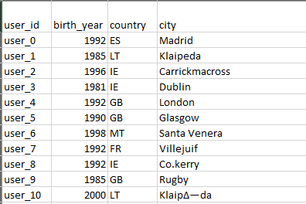
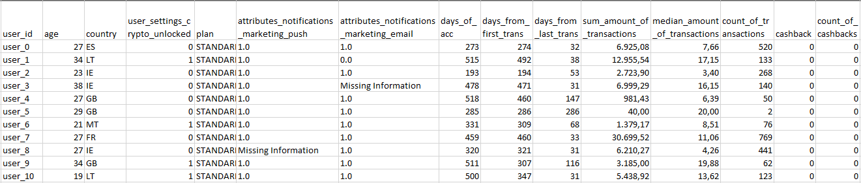
Data Pre- Processing
Identified and resolved data-quality issues such us inconsistent formating, missing data entries and inaccuracy of the data and modified the data to make them easier to process

Slide 2
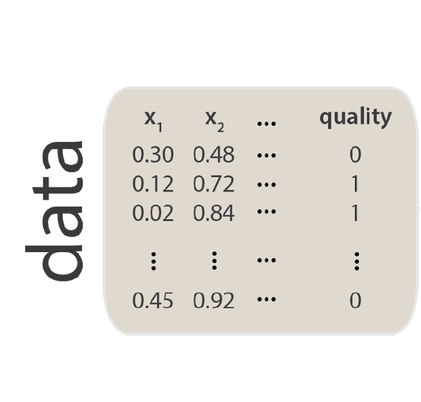
2. Feature Engineering
1
2
3
4
Pre-processed dataset
Split into two subsets
Data Transformation
Balance the dataset
TEST SET
Variables Encoding
-
Feature
Scaling
20%
92% Standard
(13.672 users)
Vs
8% Paid
(1149 users)
TRAIN SET
80%
10.700 users each

Slide 3
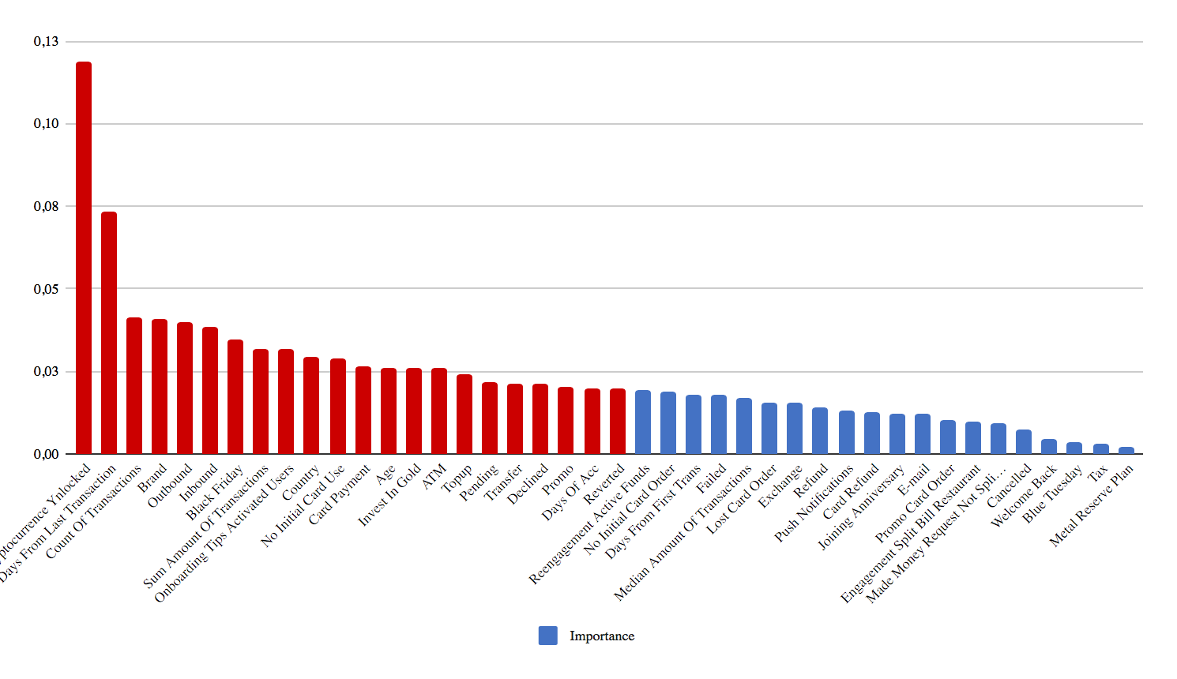
3. Feature Selection
Extra Trees Classifier was used to identify the importance of each feature

Slide 4
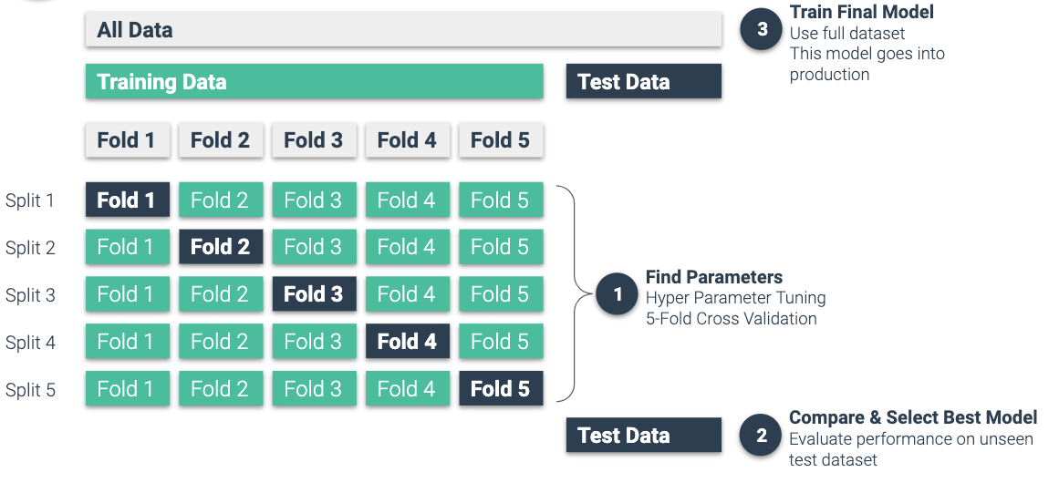
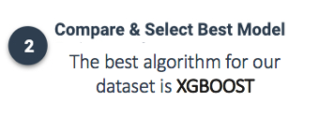
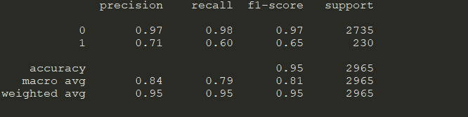
4. Model Selection
80%
20%
The best algorithm for our dataset is XGBOOST

Slide 5
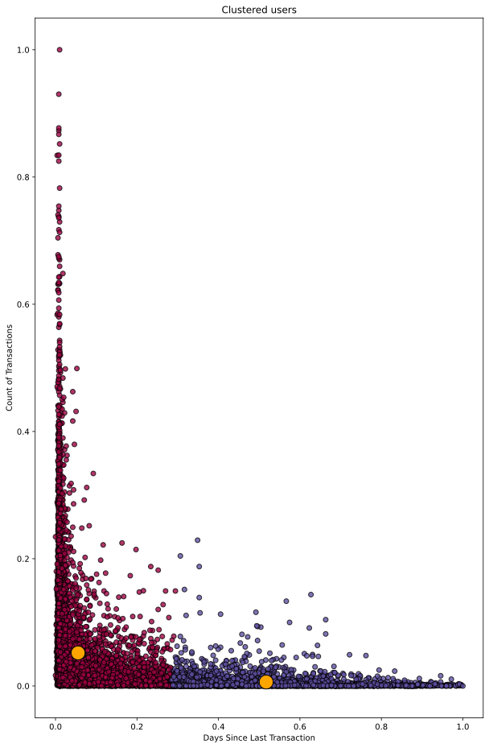
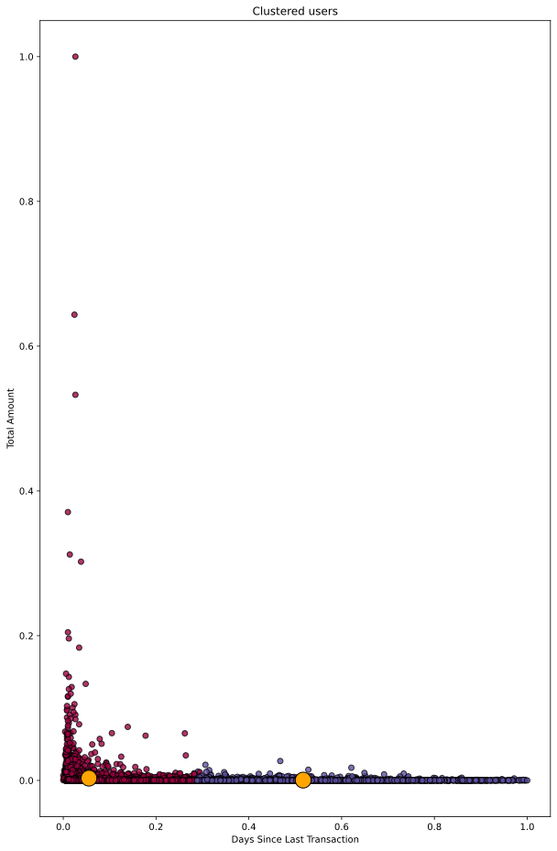
User Modelling
K-Means
Clustering
Group 1
Group 1
Group 2
Group 2

Slide 6
User Modelling
Group 1
Users : 11875
Group 2
Users : 2946
Average User
Average User
Days Since Last Transaction | 55.46
Amount ( $ ) | 10067.76
Count of Transactions | 156.59
Days Since Last Transaction | 282.62
Amount ( $ ) | 1368.71
Count of Transactions | 19.00
Engaged Users
Unengaged Users

Slide 7
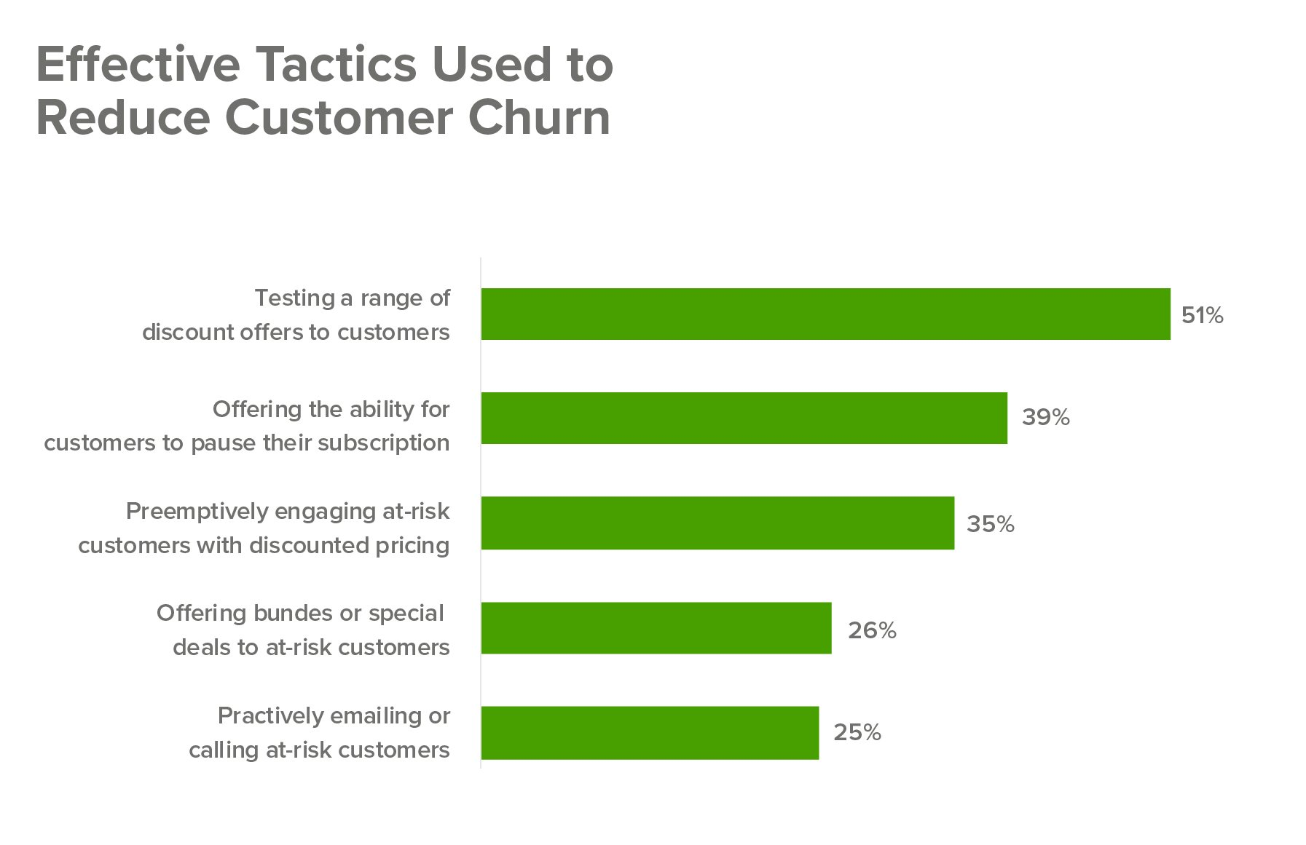
5. Churn Users Strategies
1. Analyze why churn occurs
2. Actively engage with the customers through communication channels (email, social media etc.)
3. Offer incentives (discounts, special offers etc.)
4. Give better service

Slide 8
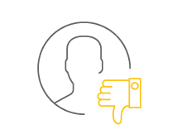
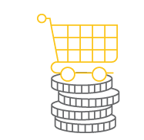
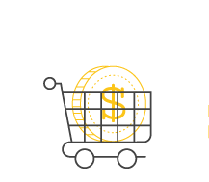
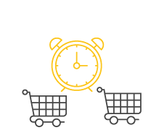
5. Churn Metrics
*measure every 6-12 months
Customer Churn Rate %
(CCR)
Revenue Churn Rate %
(RCR)
Average Transaction Value
(ATV)
Time Between Transactions

Slide 9

Thank you !

